Slide 1
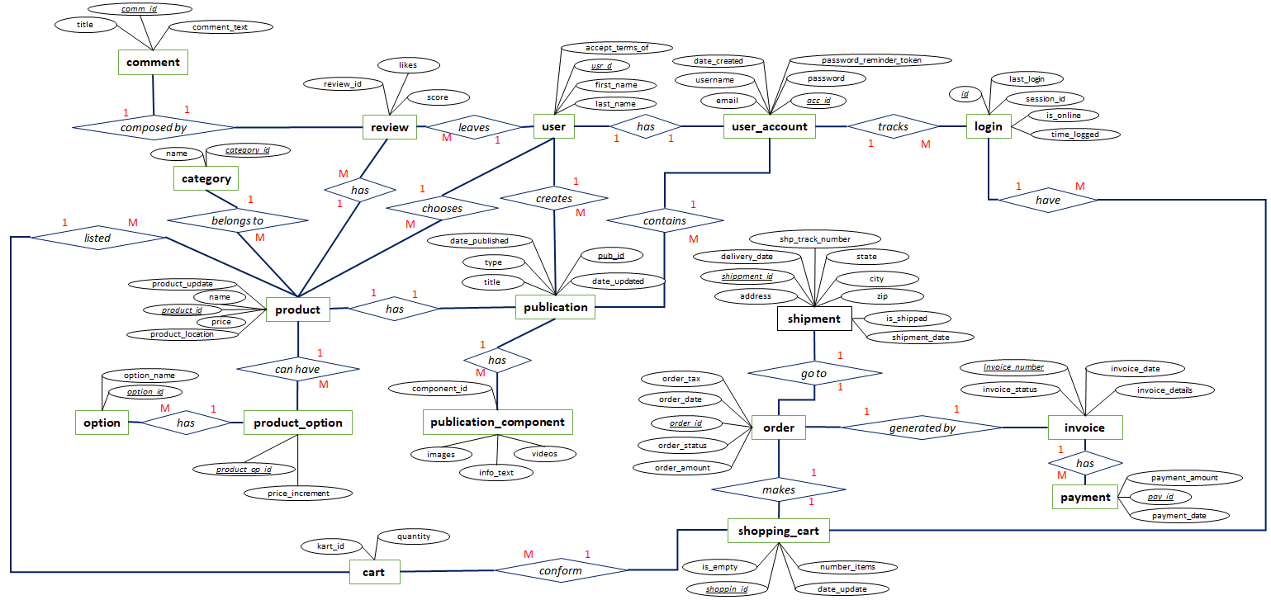
Conceptual ER Diagram
DesignHub Website Application

Slide 2
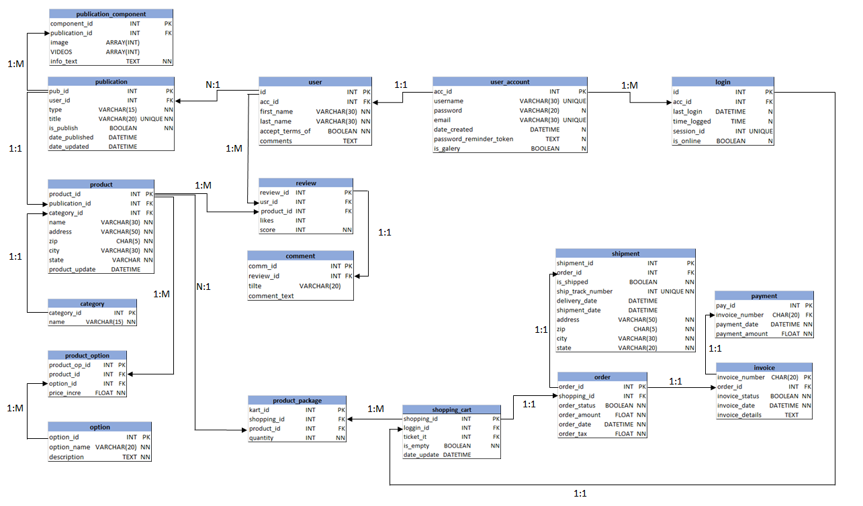
Logical ER Diagram
DesignHub Website Application
Constrains Index
PK Primary Key
FK Foreign Key
NN Not NULL

